Slide 1

Efficient Solver for
Dynamic Puzzle Games:
Baba Is Y’all
Instructor：Jialin Liu
Member：Xianqing Zeng, Yuhang Lin
2023/3/30

Slide 2

Content
Introduction
Background
Baba Is Y’all
Algorithms & Experiments
Future

Slide 3


1
Introduction

Slide 4

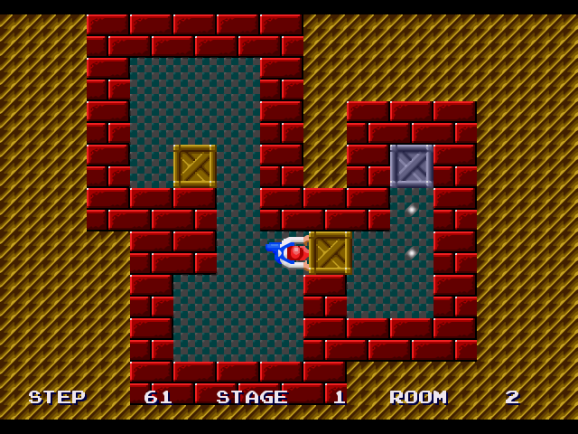
Puzzle Category
Puzzles with static rules:
2. Puzzles with dynamic rules:
Sokoban (https://gamefabrique.com/storage/screenshots/genesis/sokoban-05.png)
Monument Valley (https://img.zcool.cn/community/01e9975bc57fbba8012099c8597b77.jpg@1280w_1l_2o_100sh.jpg)
1/10
Notes:
https://www.youtube.com/watch?v=z9ptOeByLA4&ab_channel=EvolvingAILab

Slide 5
2
Background

Slide 6


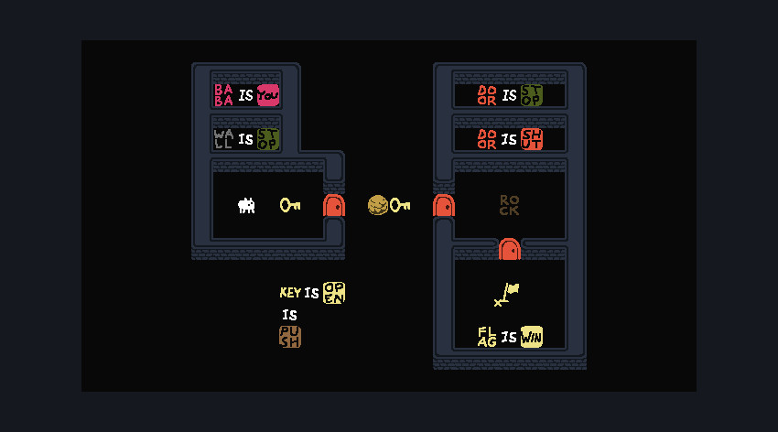
Baba Is You: full version
https://store.steampowered.com/app/736260/Baba_Is_You/
3/5

Slide 7
Baba Is You: Jam version
https://hempuli.itch.io/baba-is-you
3/5

Slide 8
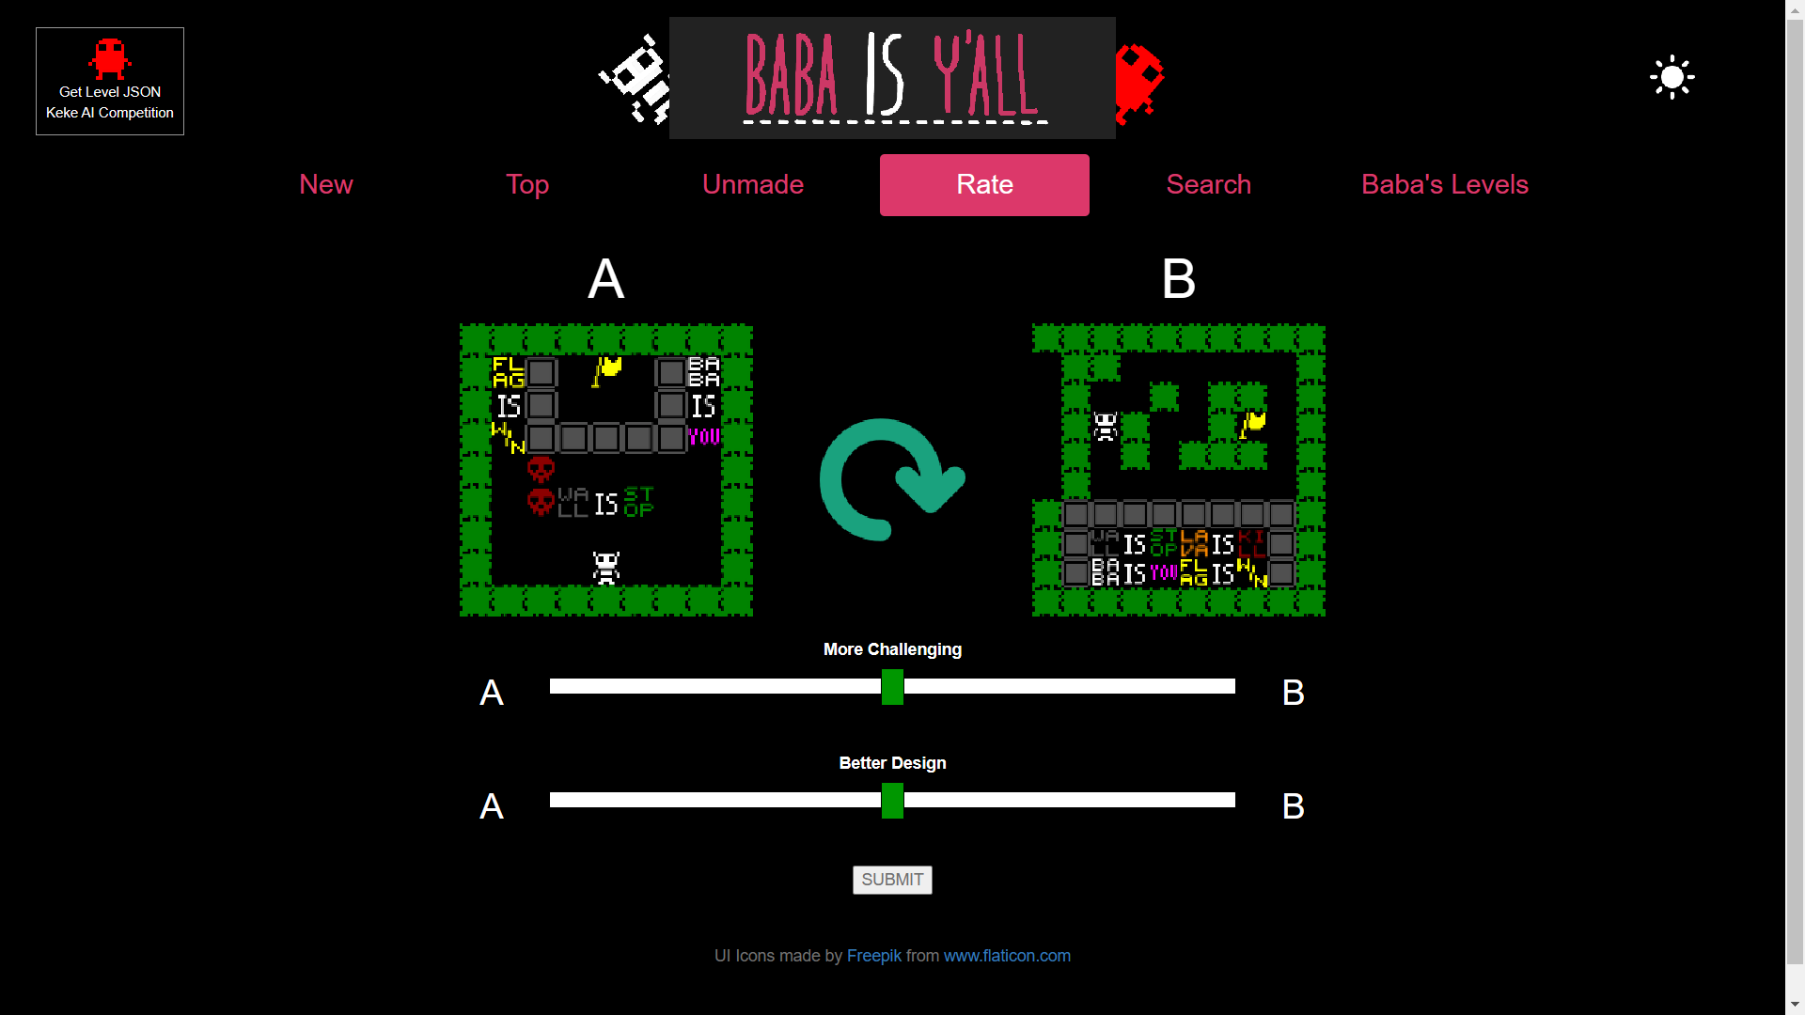
Baba Is Y’all: framework
http://equius.gil.engineering.nyu.edu/map_home.php#rate_screen
3/5

Slide 9
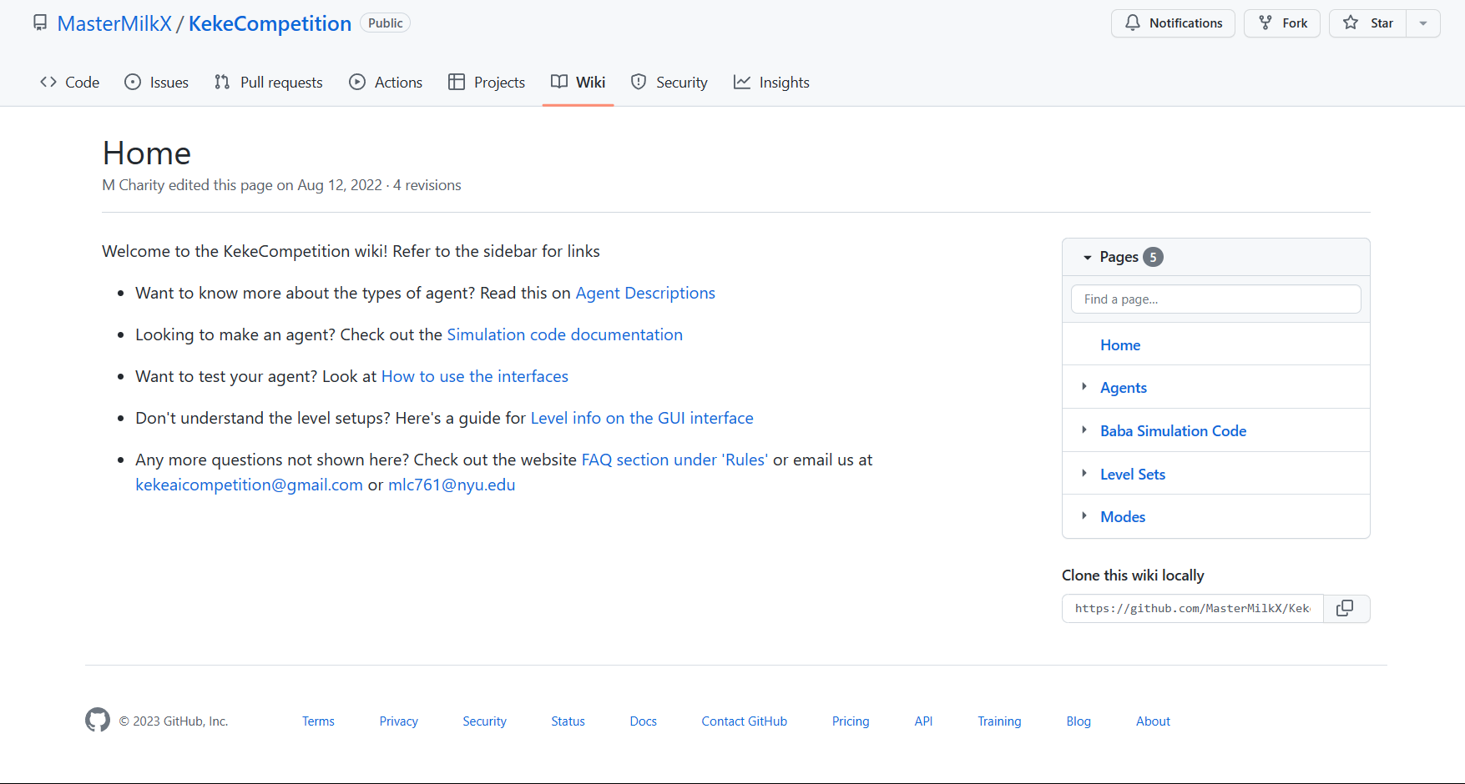
Keke AI Competition
https://github.com/MasterMilkX/KekeCompetition/wiki
3/5

Slide 10
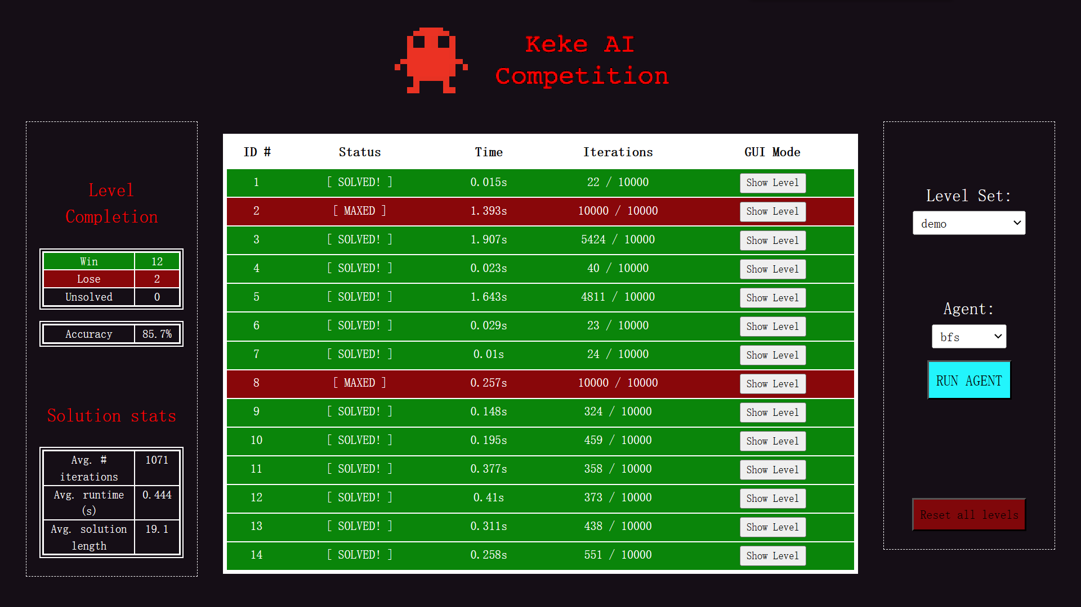
Keke AI Competition
https://github.com/MasterMilkX/KekeCompetition/wiki
3/5

Slide 11
3
Baba Is Y’all

Slide 12
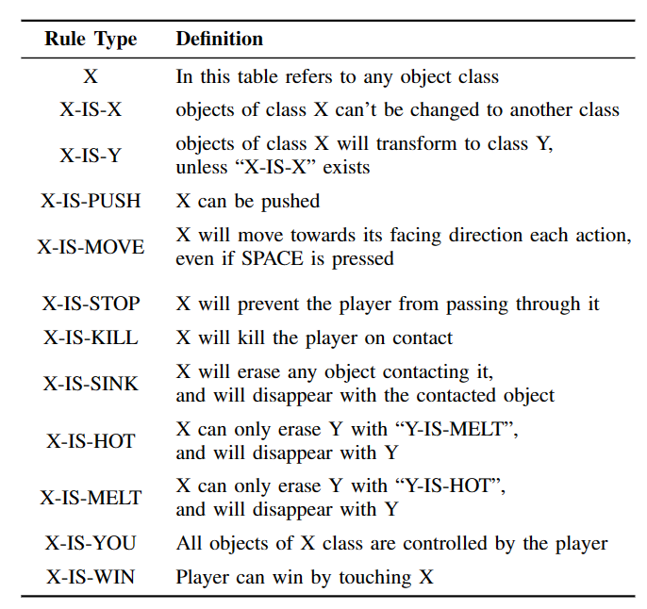
Keke AI Competition
4/5

Slide 13
Keke AI Competition
4/5

Slide 14
4
Algorithms & Experiments

Slide 15
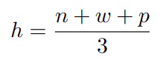
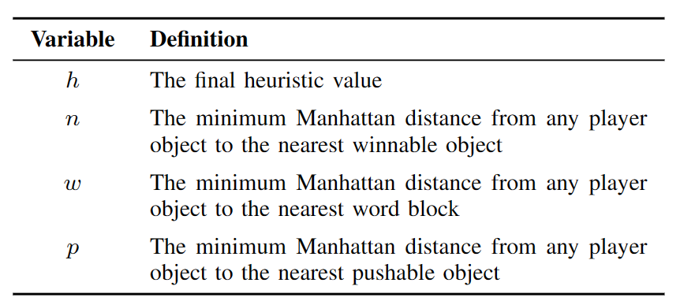
Heuristic in framework
4/5

Slide 16
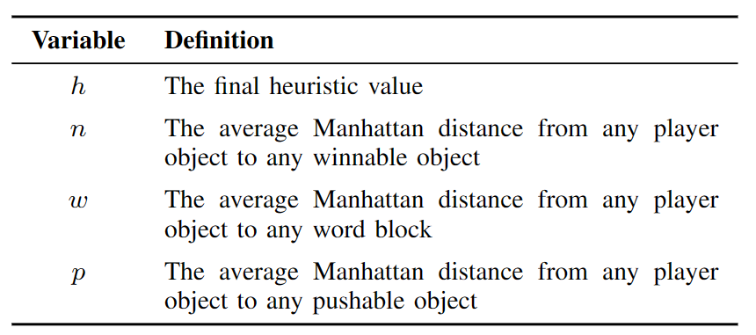
Heuristic in CoG 2022
4/5

Slide 17
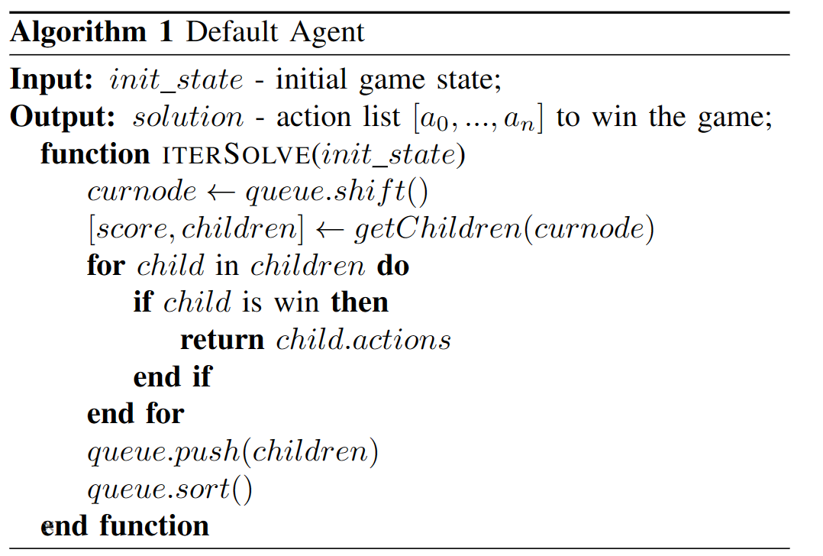
Pseudocode for Default Agent
4/5

Slide 18
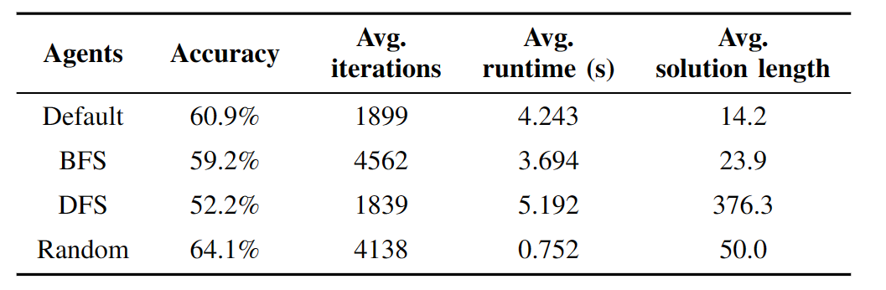
Comparison of 4 agents in Cog 2022
4/5

Slide 19
5
Future

Slide 20
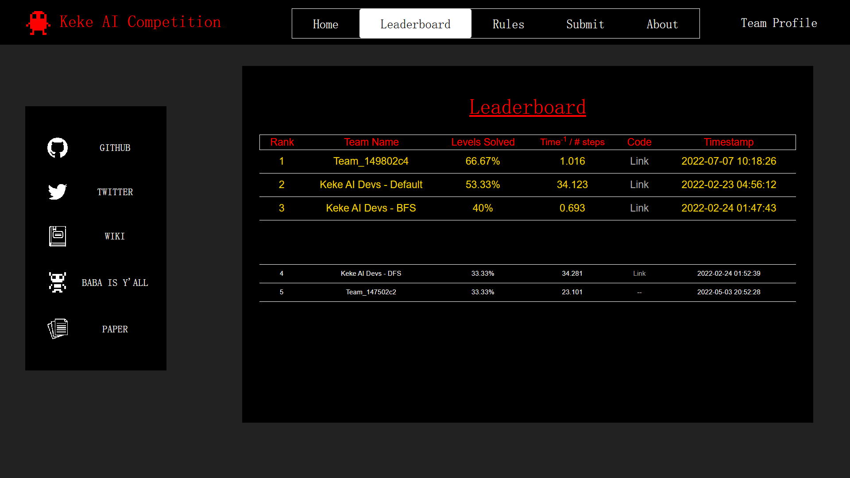
http://keke-ai-competition.com/

